Slide 1
Does more information equate better payoff?
William Weng, Kexin Yang
December 2, 2019

Slide 2
Blackjack is much more complex than we think
Agent’s Hand:
A Partially Observable Markov Decision Process:
No complete information about current game state
No obvious optimal strategy
An unfair game:
Without additional information, the expected payout is always negative
However, in reality, some people seems to be able to win lots of money and get a positive overall payout from this game by applying certain strategies
Two
Three
Dealer’s Hand:
Ten
Faced Down
Notes:
Show of hand - who had gambled before? In a casino
More than 10 different types of blackjack. Varies by different states and casino you go to.

Slide 3
Past researches focus on optimization of model policy
Research: “Playing Blackjack with Deep Q-Learning”
What they did:
Implements a DQN model which accepts the information about current hands and approximates the expected rewards of taking each possible action
Optimized the hyperparameters of network structures
Evaluate the model by comparing the model policy with a close-form optimal policy
This research shows that DQN model can achieve a good performance in Blackjack game, but they did NOT investigate the effect of additional memory information!
Notes:
Many other research about Blackjack but this is most relevant

Slide 4

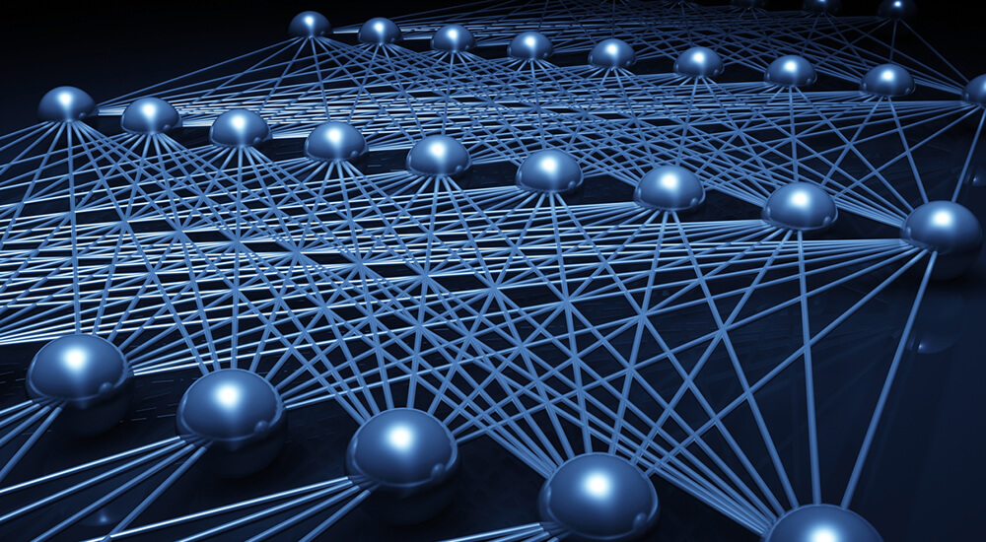
But how does memory affect NN’s performance?
Can additional memory information also help a Neural Network model achieve better performance in a probabilistic game such as Blackjack?
If so, what is the relation/correlation between the amount of additional memory information and the model performance?

Slide 5
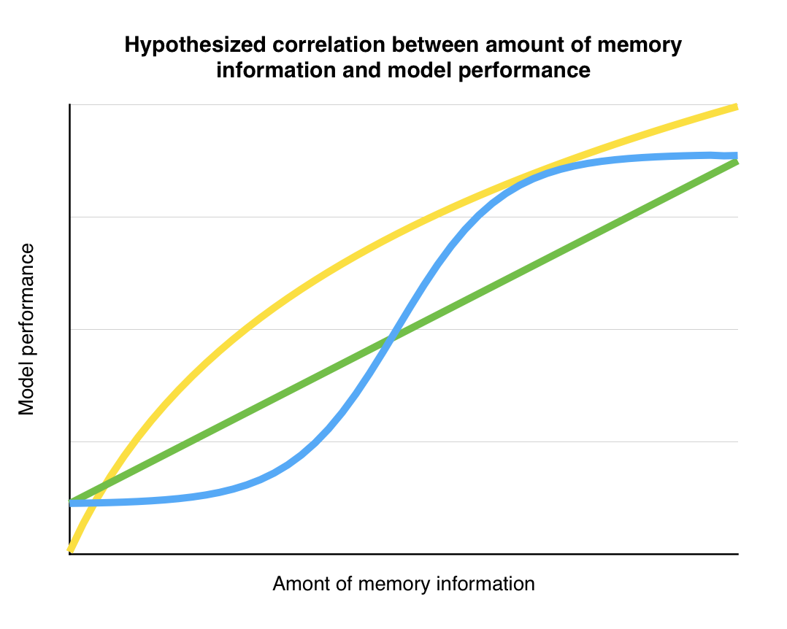
Our hypothesis
Additional memory information could help a Neural Network achieve better performance on a Blackjack game.
A Sigmoid relation between the amount of additional memory information and model performance
Notes:
Additional graphs. Different structures
Sig
Linear
Log

Slide 6
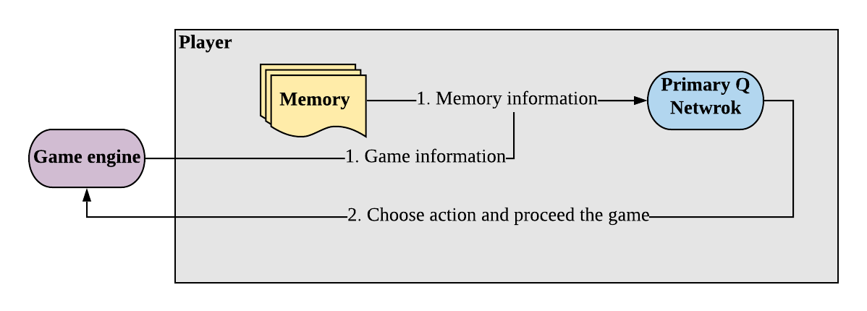
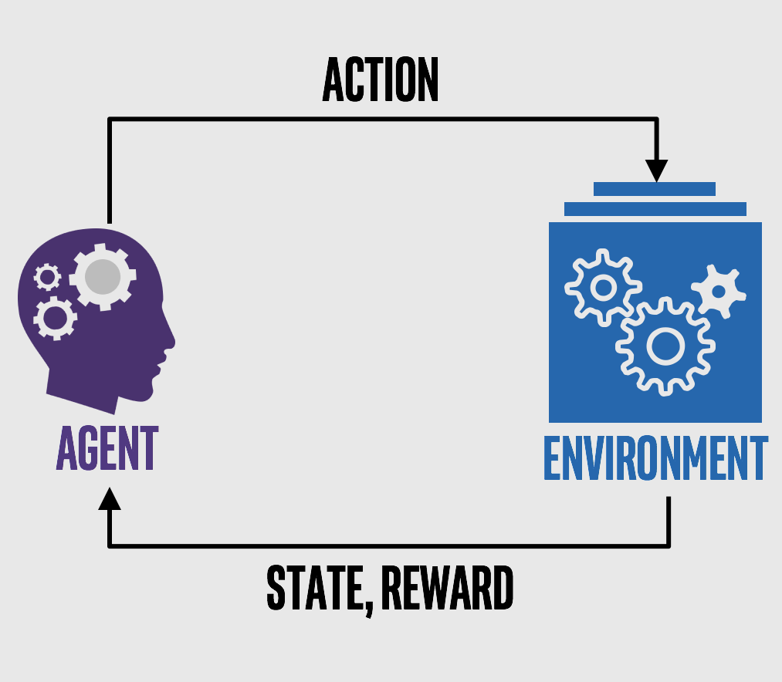
Overall structure of our model
Game engine initials the game
Game and player memory information are sent into the primary Q network
Player chooses an action based on the output
Game engine receive the action and proceed the game
Notes:
Our implementation has two major parts: game engine which manages the blackjack game environment, and player which makes actions based on our neural network model
To look at the flow of this implementation:
first Game engine initials the game
Game and player memory information will then be sent into the primary Q network, which produces an output of two nodes, representing a probability to choose each of the two action
Player will choose an action based on these probabilities, and
Game engine will proceed the game according to the player’s action

Slide 7
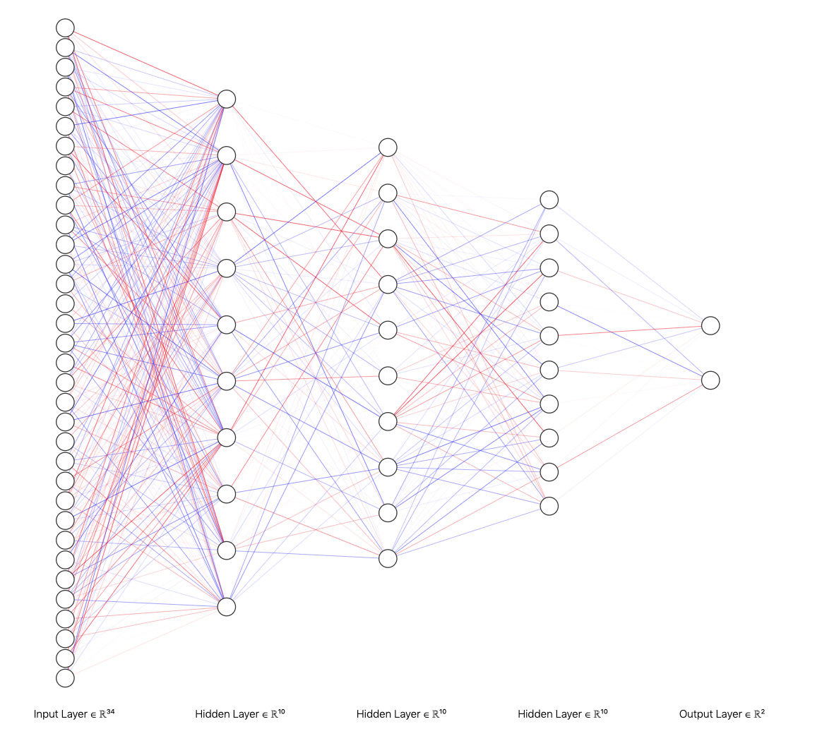
Model Specification
Input layer: 34 input nodes. 10 for current hands of the player. 10 for current hand of the dealer. 10 for memory of the agent. Last four stands for small observations from the game (sum and ace)
Hidden layers: 3 layers each with 10 nodes.
Output layer: Two nodes, meaning hit or stand. Each encodes a probability of such action with a sum of 1.
Notes:
Needs new graph

Slide 8
Agent’s Hand:
1
#11
#1
1
#2
#12
Ace
Two
Three
1
#3
#13
#4
#14
#5
#15
#6
#16
Dealer’s Hand:
#7
#17
Ten
Faced Down
#8
#18
#9
#19
#10
1
#20
Notes:
Our input layer hardcodes the number of card each value has.
For example in this situation, agent has …
Dealer is the same way, except it only sees one card

Slide 9
Past Cards
#21
#22
Ace
Five
Six
#23
1
#24
#25
Sum of all these nodes is 3 (the memory size)
Memory Size of 3:
2
#26
Six
Six
Four
#27
#28
#29
#20

Slide 10
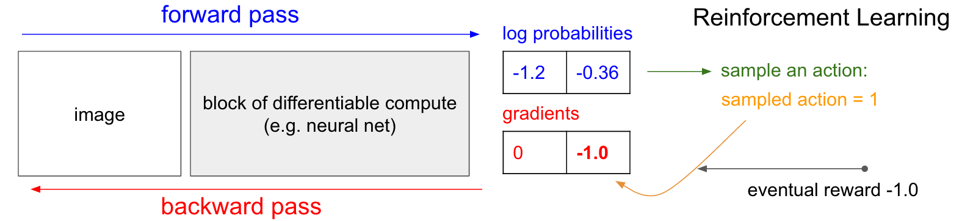
Training the model is tricky
Problem 1: How do we backprop if we do not have a correct response?

Slide 11
Training the model is tricky
Problem 2: In the nature of a sequential game, how should we assign rewards?
Draw
Draw
Stand
WIN
LOSS
LOSS
LOSS
Draw
Draw
Draw
Stand
Draw
Draw

Slide 12
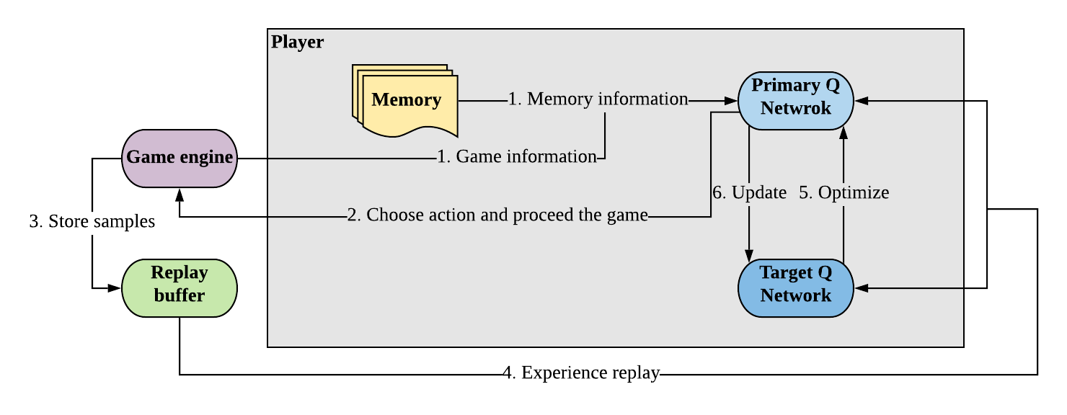
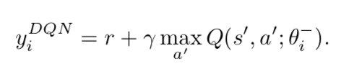
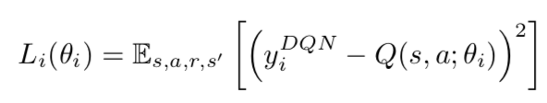
Deep Q-Learning Network addresses both issues
Targets:
Minimize Loss:
Notes:
To deal with these two issue, in our Deep Q Network, we construct a label for each prediction as the most desirable value we can get at each state, and it is called the target value for a state
Need a label: target q value is composed of the action rewards of the current state and the maximum Q value from the next state to approximate the best possible value a player can achieve at the current state by performing an action
Optimize the weights for our model by minimizing the loss: calculated as the MSE of target and prediction q value -- like the “error” in supervised learning
Another issue worth mentioning is that blackjack is very experienced based and it has a lots of possible states, so any single sample can not represent the entire game dynamic, and the network can suffer from the bias of outlier samples. So to account for this possibility, we applied a method called experience replay which looks at a batch of randomly chose samples at a time to help the model get a better representation of the overall game.

Slide 13
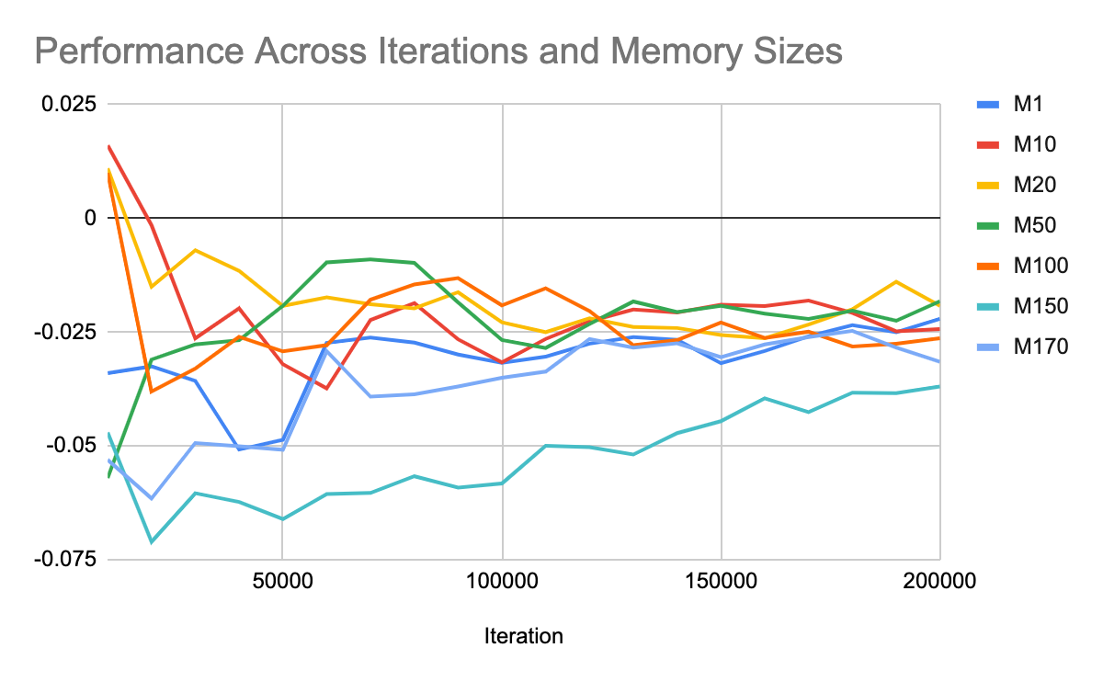
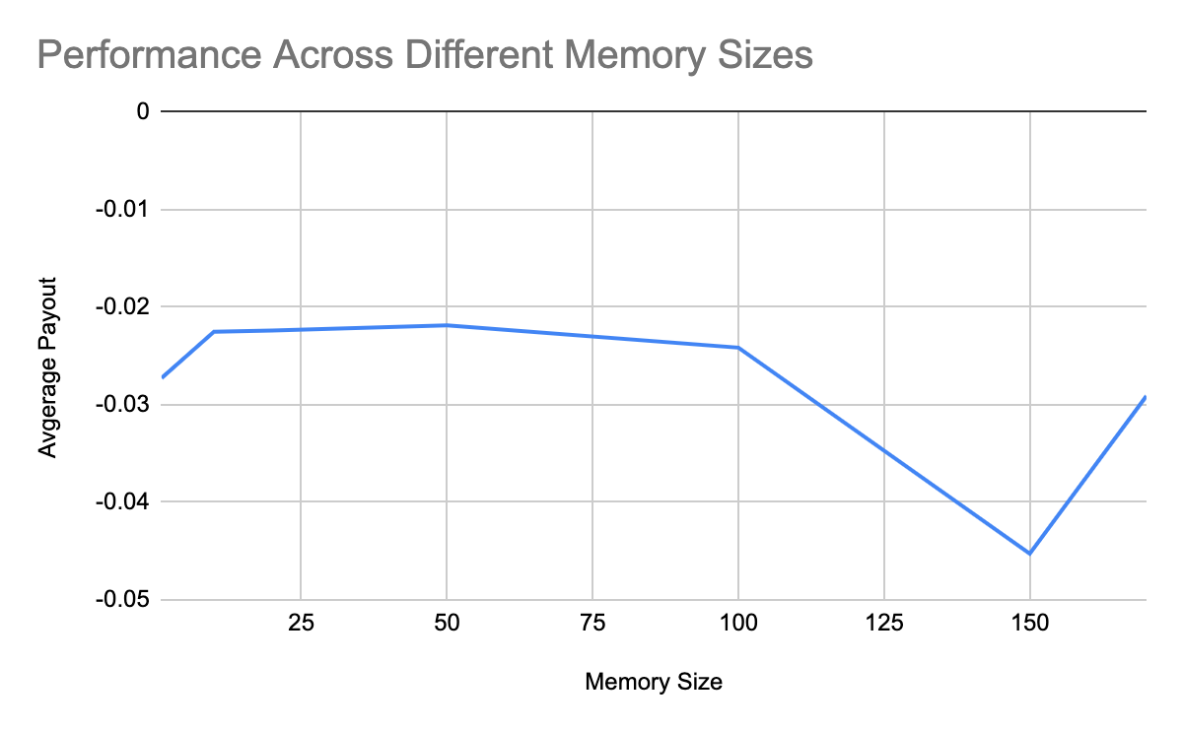
Results from the model are promising
Notes:
Fast!!!!!
Converge.
Good performance
But does not increase

Slide 14
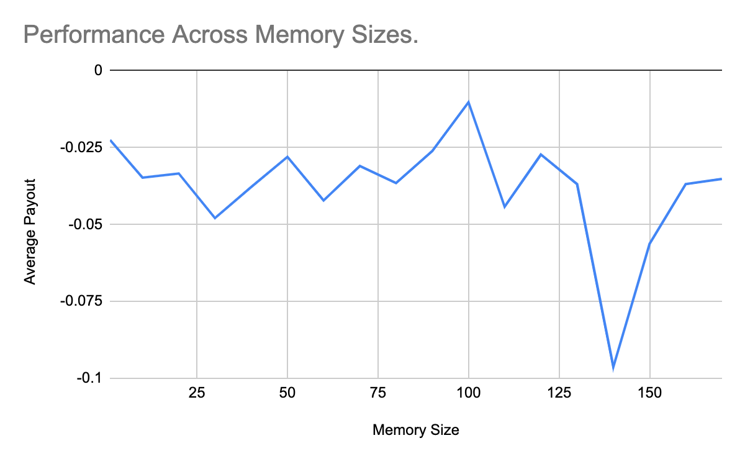
Results also tell us that our NN does not improve with new memory
Why?
Model does not understand what is happening.
Solutions:
Add new input nodes to help the model to understand.
Reformatted how we encode memory data.
Corrected previous model errors.
Notes:
Mainly we added in and made minor tweaks

Slide 15
Realization: our NN does not respond to memory the way we envisioned
Existing Model:
Input from the board
NN (Black Box)
Action
New Model:
Input from the board
Distribution Belief
NN (Black Box)
Action
Notes:
Now, after our refined model fails again, we knew we were doing something off. So we took a step back and examined our model.
What our current model is essentially doing is combining all these inputs from player, dealer, and memory together into the black box (the NN) and asking it to calculate an action.
We do not know exactly how memory is used by our model, but we know it is wrong. So, we decided to extract the memory portion out of the black box and tell the model explicitly what to do with memory data.
But how should the model use the memory data? For us, why additional memory helps us is because we can have a better understanding of the distribution of future cards. So, we asked our model to construct a distribution belief for future cards by using the memory data. After compiling such belief, the output is again inputed to the PQN for reinforcement learning. This way, by giving the model explicit instruction on how to use the data, we hope to see a difference.

Slide 16
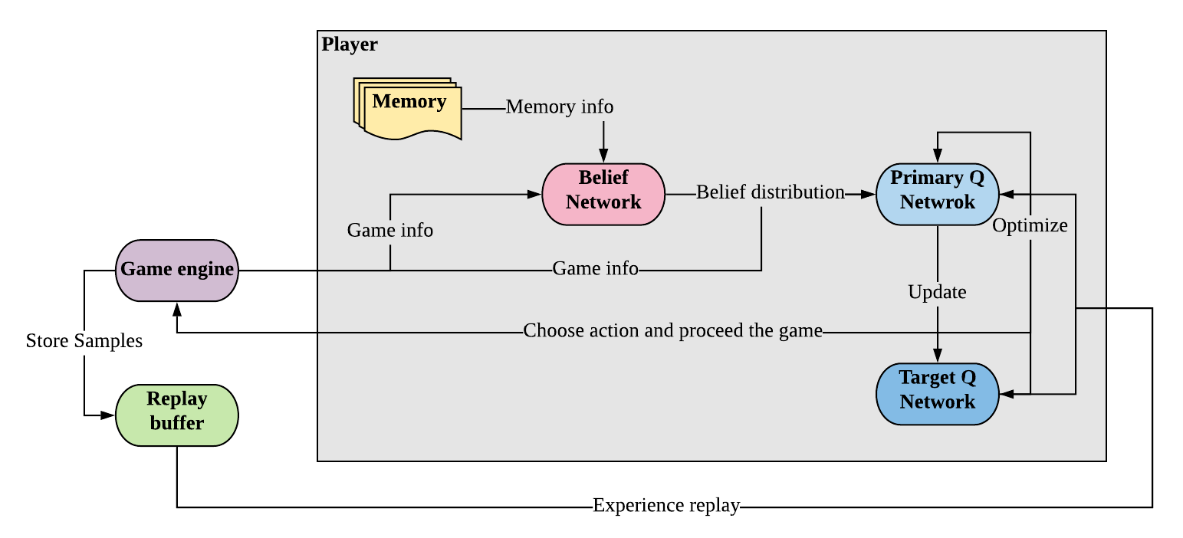
We told our new model exact how to use memory information
Notes:
In this new model, we simply add the additional belief network between the game engine and Primary Q network

Slide 17
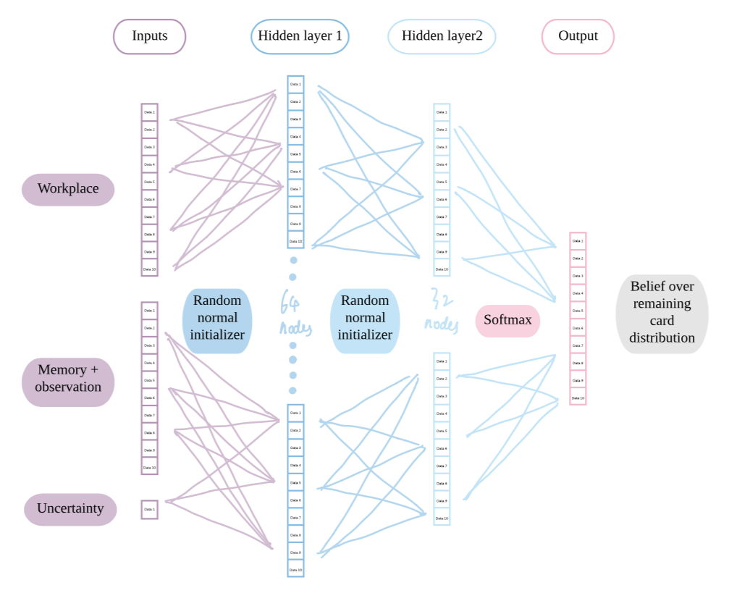
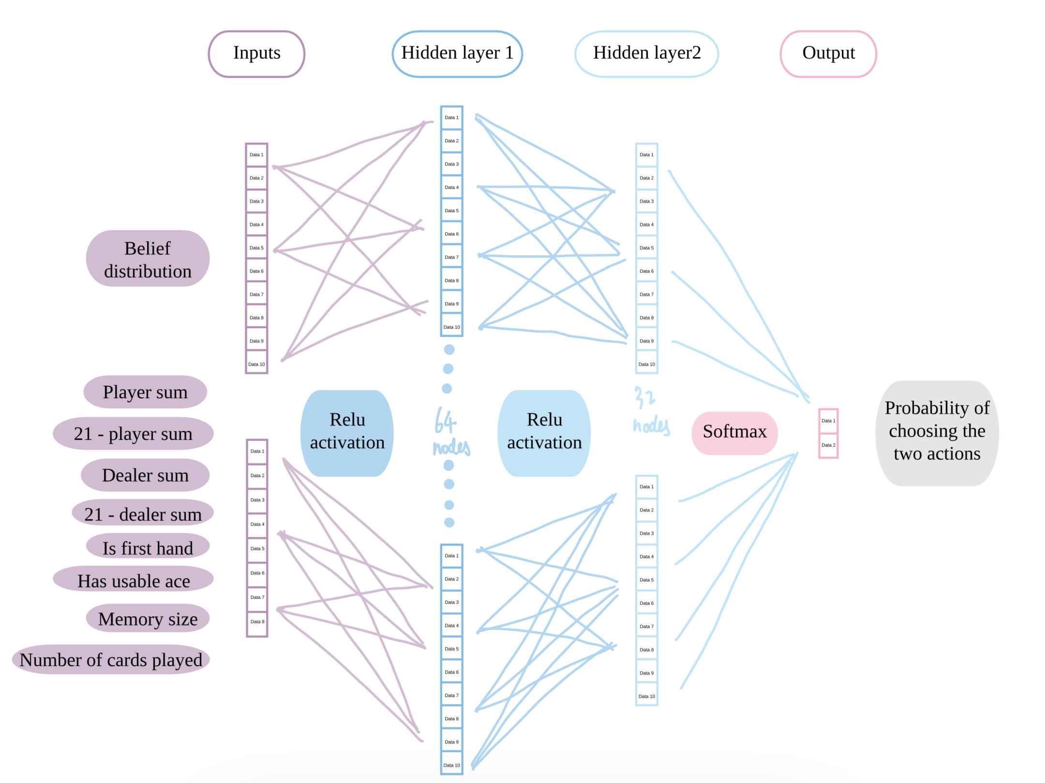
Breakdown of inputs and outputs
Belief Network
Primary Q Network
Notes:
BN: 21 input nodes(first 10 represents the cards that are shown on the current workplace, the second 10 represents the cards in player’s memory as well as the player’s observation of current state cards, and the last one represents the player’s uncertainty over his memory information)
These inputs are then passes into 2 hidden layers, and then an output layer with softmax that produce 10 nodes to make sure the values sum up to one to represent the player’s belief over remaining card distribution
QN: Outputs from belief network are then used as the first part of input of QN. These outputs are concatenated with 8 other nodes that encodes information about the current game state, which we believe is important to the decision making process. Simply put, we made it more visible to our model.

Slide 18
Training the belief network
Current belief distribution
New cards drawn
0.1
#1
0
#1
Intuition:
Push player’s belief distribution towards a more “correct” direction
0.2
1
#2
#2
( )
2
0.1
#3
1
#3
0.05
#4
0
#4
0.05
#5
0
#5
0.1
#6
0
#6
0.3
#7
0
#7
0.03
#8
0
#8
0.04
#9
0
#9
0.03
#10
0
#10
Notes:
To train our belief network, the intuition is that we want to Push player’s belief distribution towards a more “correct” direction, since the player do not know the actual distribution due to limited memory size
Mathematically speaking, in the long run, If a card is drawn at this round, it should have had a relatively high percentage in the previous belief distribution, and we want to make sure that this is true in the belief distribution generated by our belief network
So we calculate the loss as the Mean squared error between the current belief distribution and new cards draw from the deck

Slide 19
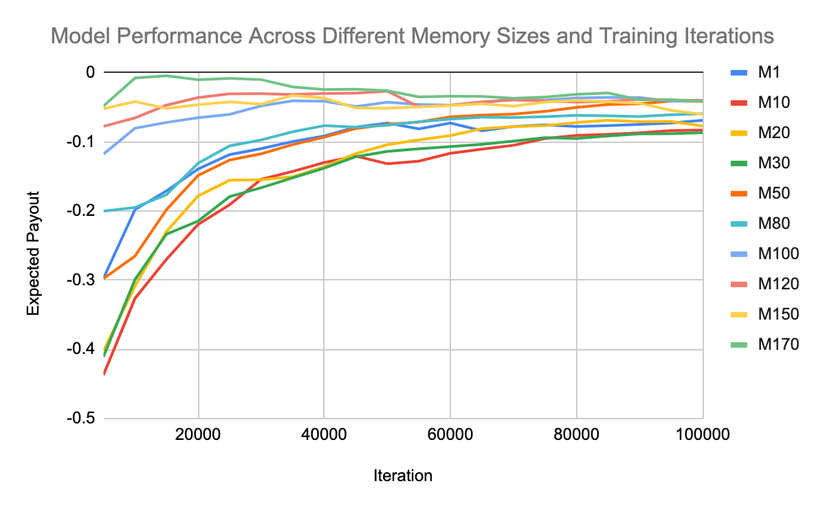
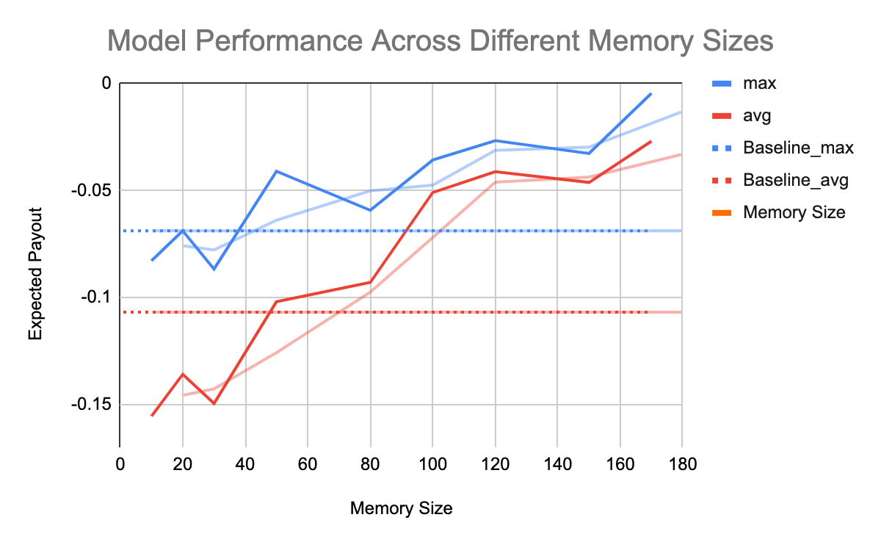
New model results show positive relationship between memory size and performance

Slide 20
Conclusions
NN performance does not increase if we do not tell the model explicitly what to do with additional memory information because the hidden layer is a black box for us; when we want our model to use certain information in a certain way, we should make it explicit, so the model could match its mission.
Although NN is a black box, we could achieve better outcome by placing the black box in different positions. And how we come up with such placement of the black box could be inspired by our very own brain.
Notes:
And this is more than the game of blackjack. In general, simply giving the model more information without clear instruction of its usage could cause confusion and resulting in unchanged or even worse outcome. So, it is about how we position these information in a useful way to help our model to use it better.

Slide 21
Our model is not perfect.
Question: How to improve?
Answer:
Validating the belief network
Optimize the error correction method of the belief network
Emphasizing the direct impact of memory information and uncertainty on the action choice
Notes:
We can validate the accuracy of our belief network by comparing its output with the actual card distribution, and draw the relation between this difference and memory size to make sure the performance of belief network matches our expectation
Basically, we can repeat what we did to our last model. Add an additional neural network to let this network learns directly about the connection between action and belief distribution and memory uncertainty, and push it have a more explicit process of the fact that memory uncertainty hurts the validity of belief distribution, and learn a policy to choose action with this knowledge.

Slide 22
Thank You!
Any Questions?

